Slide 1

SMICE
Smart Rice cooker
Remote control rice cooker
https://drive.google.com/file/d/1KamaK4UEMaWFxwHUog2tcqBvg2WMpinA/view?usp=sharing
From rice to smile

Slide 2
OUR TEAM
DARYN NGUYEN
BILLY LUU
DANH LE
TRIET PHAM
Computer
Science
luudh@mail.uc.edu
Computer
Engineering
ldh@mail.uc.edu
Computer
Science
phamt7@mail.uc.edu
Electrical Engineering
nguye7td@mail.uc.edu

Slide 3

01
PROBLEM
SOLUTION

Slide 4
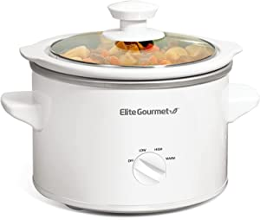

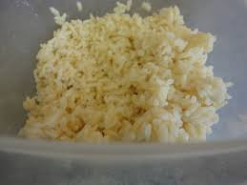
TRADITIONAL COOKER
PROBLEM
Easy to forget to turn on
Inconvenience for busy workers
Inconsistent quality of rice (human error)
Existing solutions
Slow cooker
Instant rice
Leftover rice

Slide 5
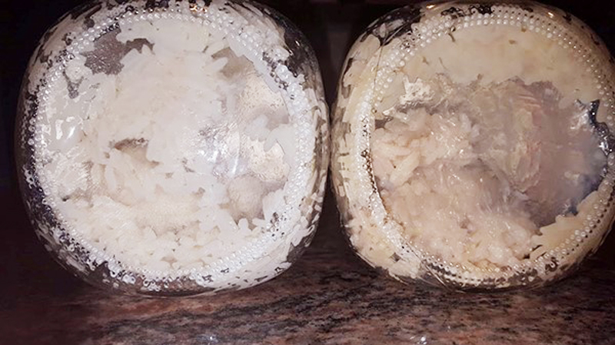
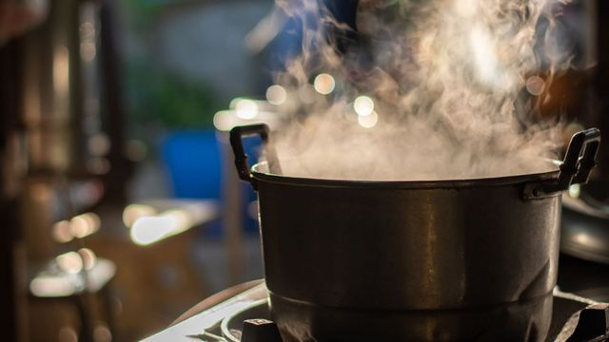
THESE SOLUTIONS’
PROBLEM
Slow cooker energy inefficiency
Instant rice unfresh, undelicious
Leftover rice unhealthy,undelicious

Slide 6
SMICE
SMART-COOKER
reliable
accurate
automatic
convenient
energy-saving
ingredients containers connected
remote control
accurate customized portion
automatic turn on mode
water level recommendation

Slide 7


REASONS FOR CHOOSING
SMICE
remote control
→ convenience, productivity
automation
→ accuracy, efficiency
parenting easier

Slide 8
02
PRODUCT
FUNCTION & FEATURES

Slide 9
COMPONENTS
CONTAINERS
HEATER
NON STICK INNER POT
DISPLAY APP
WEIGHT SENSOR
WIRELESS CONNECTION

Slide 10
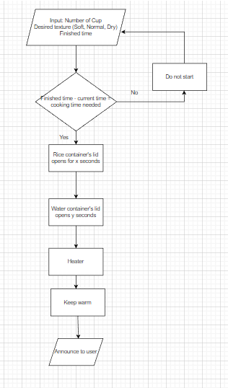
FUNCTION

Slide 11
FEATURES
CAPACITY
AUTOMATIC MODE SWITCH
DIGITAL DISPLAY
VARIABLE COOKING OPTIONS
CUSTOMIZED PORTION
WATER LEVEL RECOMMENDATION
REMOTE CONTROL
Can cook up to 10 cups
Show all process information via mobile app
Automatic turn on
to fit desired
finishing time
Allow to cook different types of rice
Calibrate to measure accurate desired
rice amount
Functioned via mobile app
Recommend preferred water level for
particular rice type

Slide 12
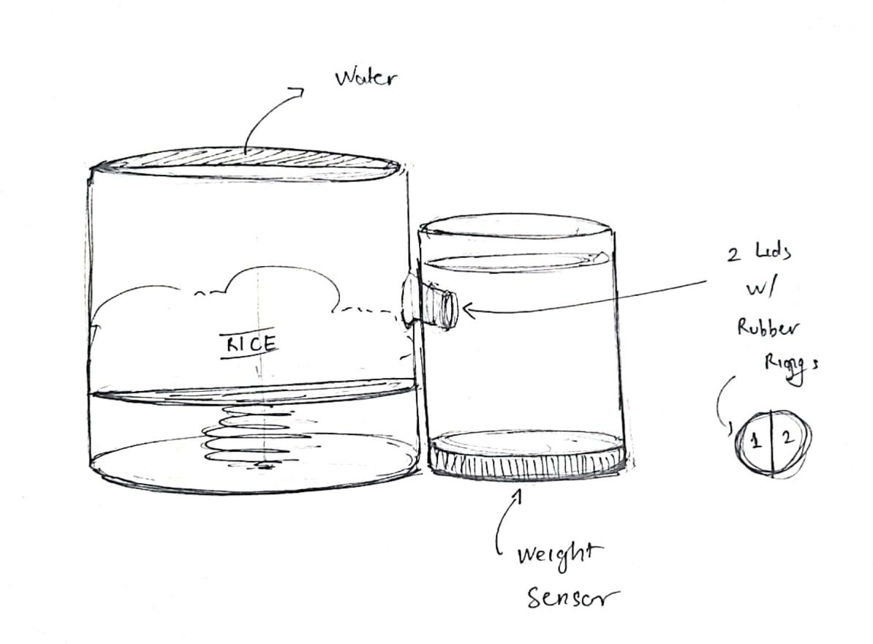
SKETCH

Slide 13
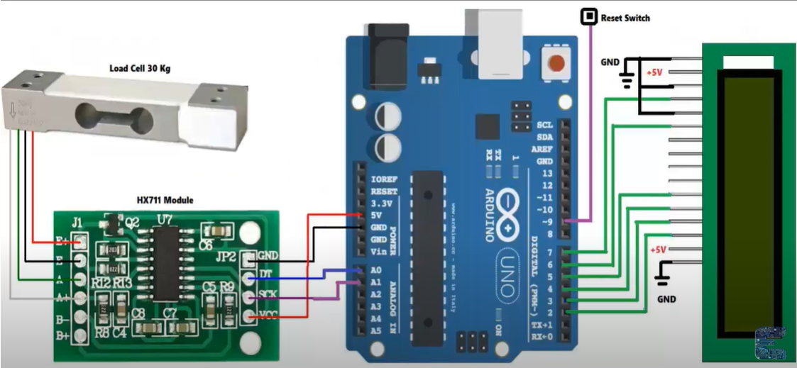
PROTOTYPE SCHEMATIC

Slide 14
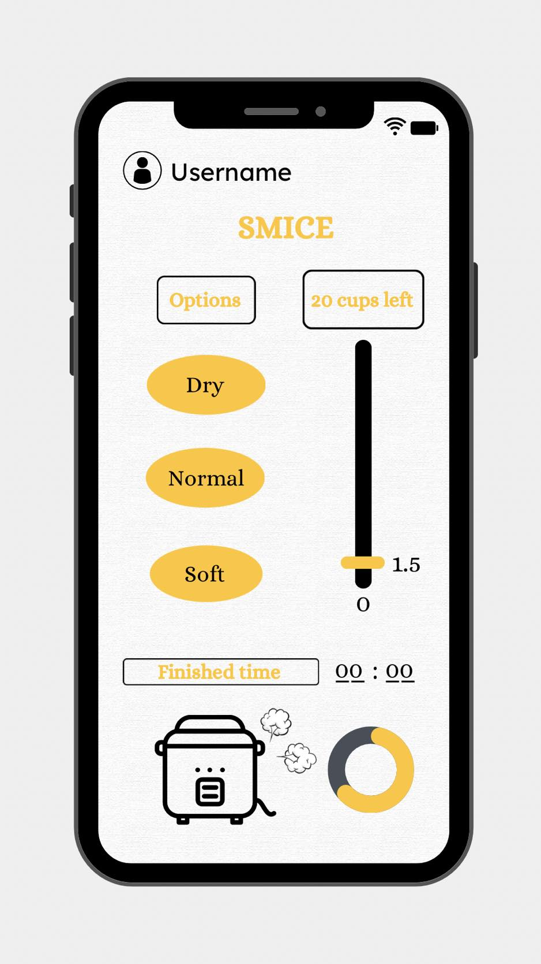
APP DESIGN

Slide 15
03 MARKET SIZE
TAM
SAM
SOM
$4500
million
$1000 million
$200 million
Total electric rice cooker market
Is expected to grow to
Automatic/Timed rice cooker market
Smice rice cooker
$6900
million

Slide 16
04 BUSINESS MODEL
Manufacturing
$100
Retailing price
$200
Profit
$100

Slide 17
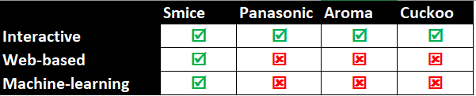
05
COMPETITORS

Slide 18
THANK YOU FOR LISTENING!
SMICE

